Slide 1
Data Science for Everyone – Data
Dr. Ab Mosca (they/them)
Slides based off slides courtesy of Jordan Crouser (https://jcrouser.github.io/)

Slide 2
Plan for Today
Data Vocabulary
Data Ethics

Slide 3
Note
hw01 released today. Find it on the course website: https://amosca01.github.io/Intro-DS-F23/

Slide 4
Data Vocabulary

Slide 5
Definition: Data
What is data? How would you define it?

Slide 6
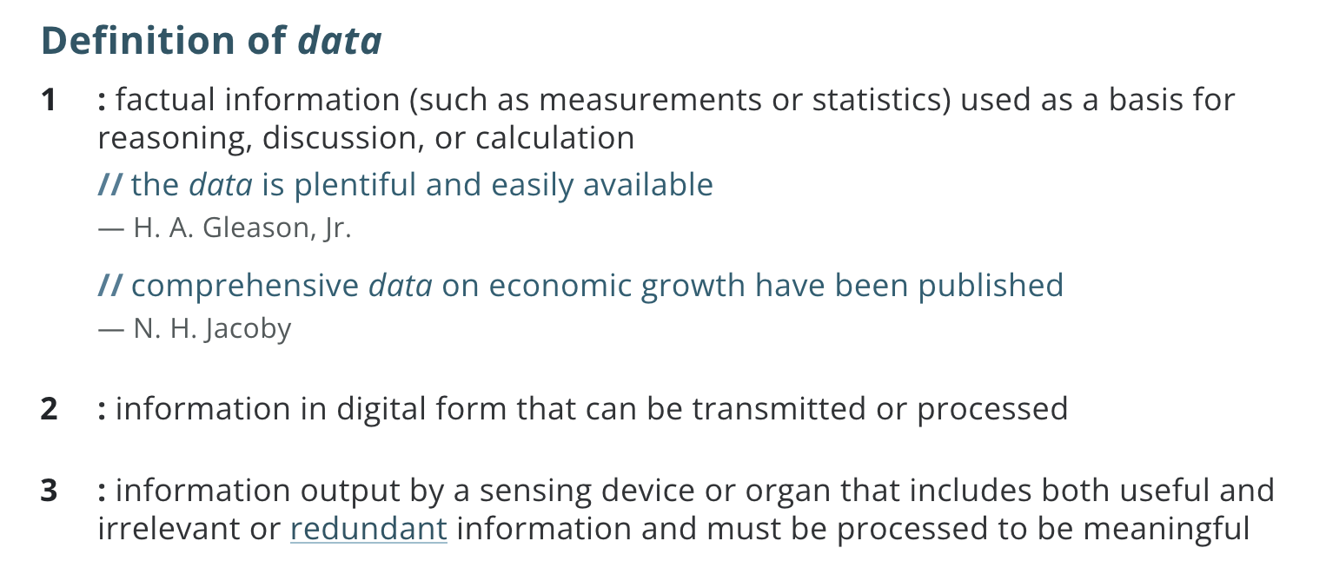
Definition: Data
https://www.merriam-webster.com/dictionary/data

Slide 7
Example of Data
Suppose you really like shoes
What information can you collect about a single shoe?
Brainstorm with whoever is next to you

Slide 8
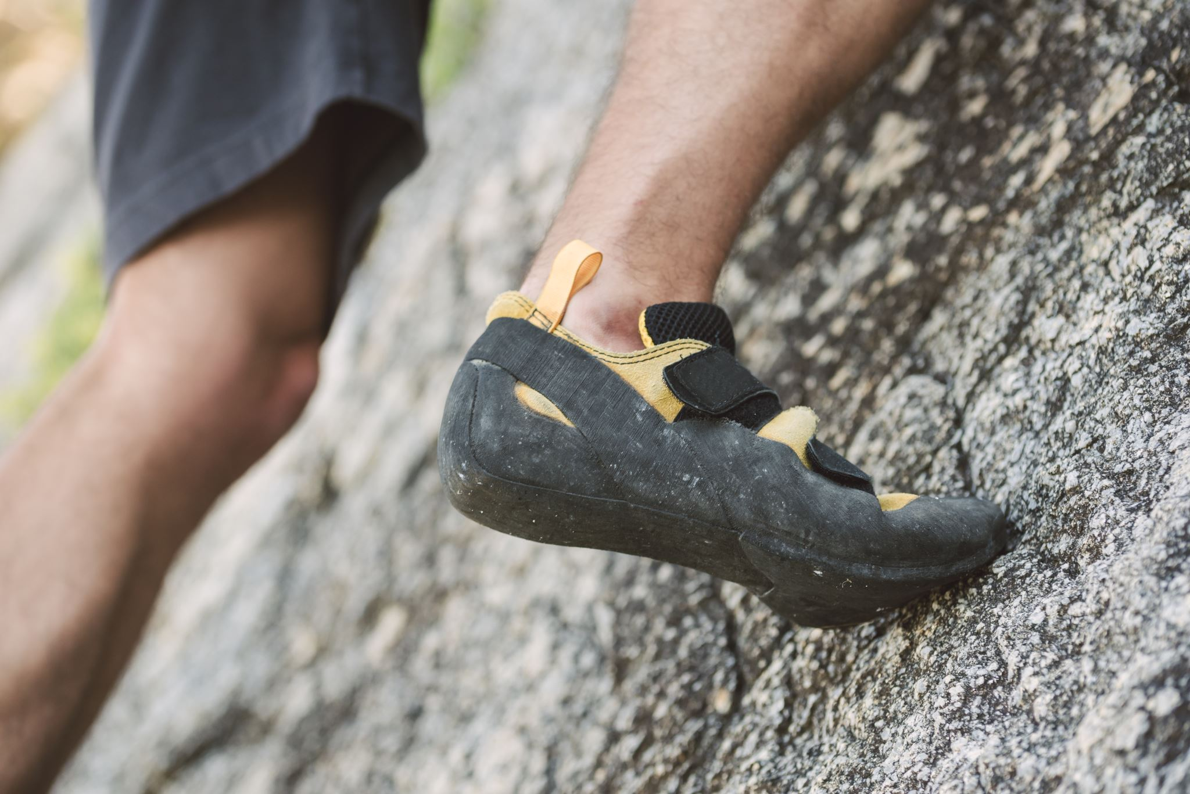
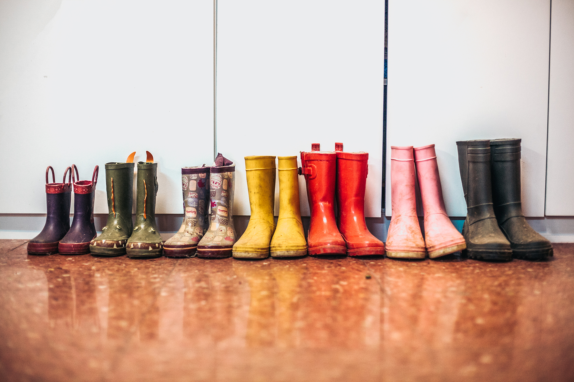
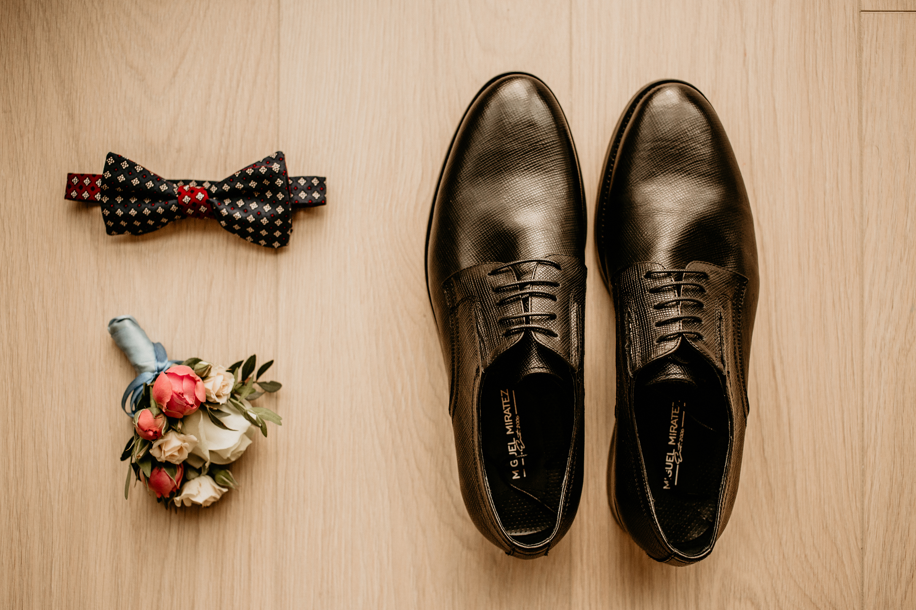
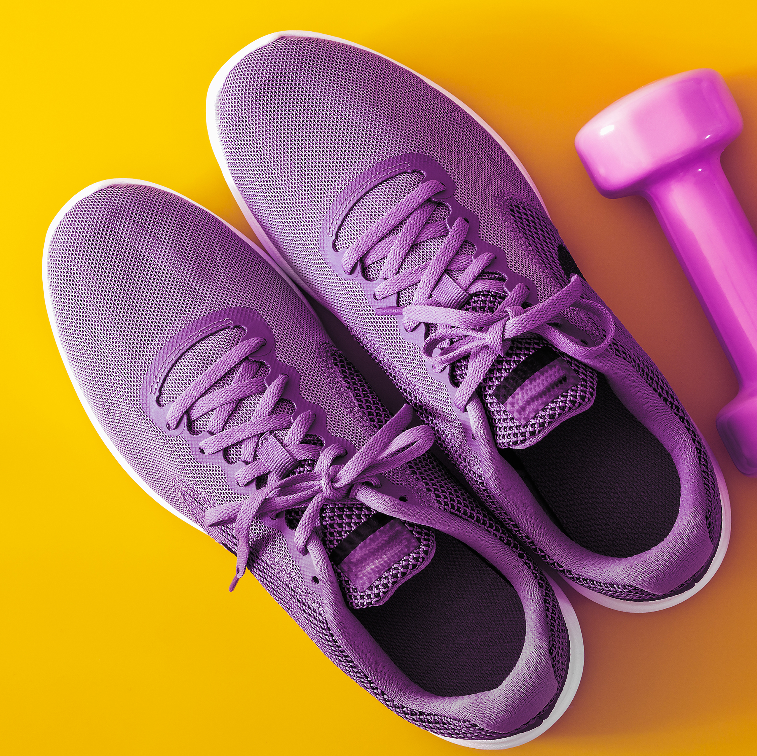
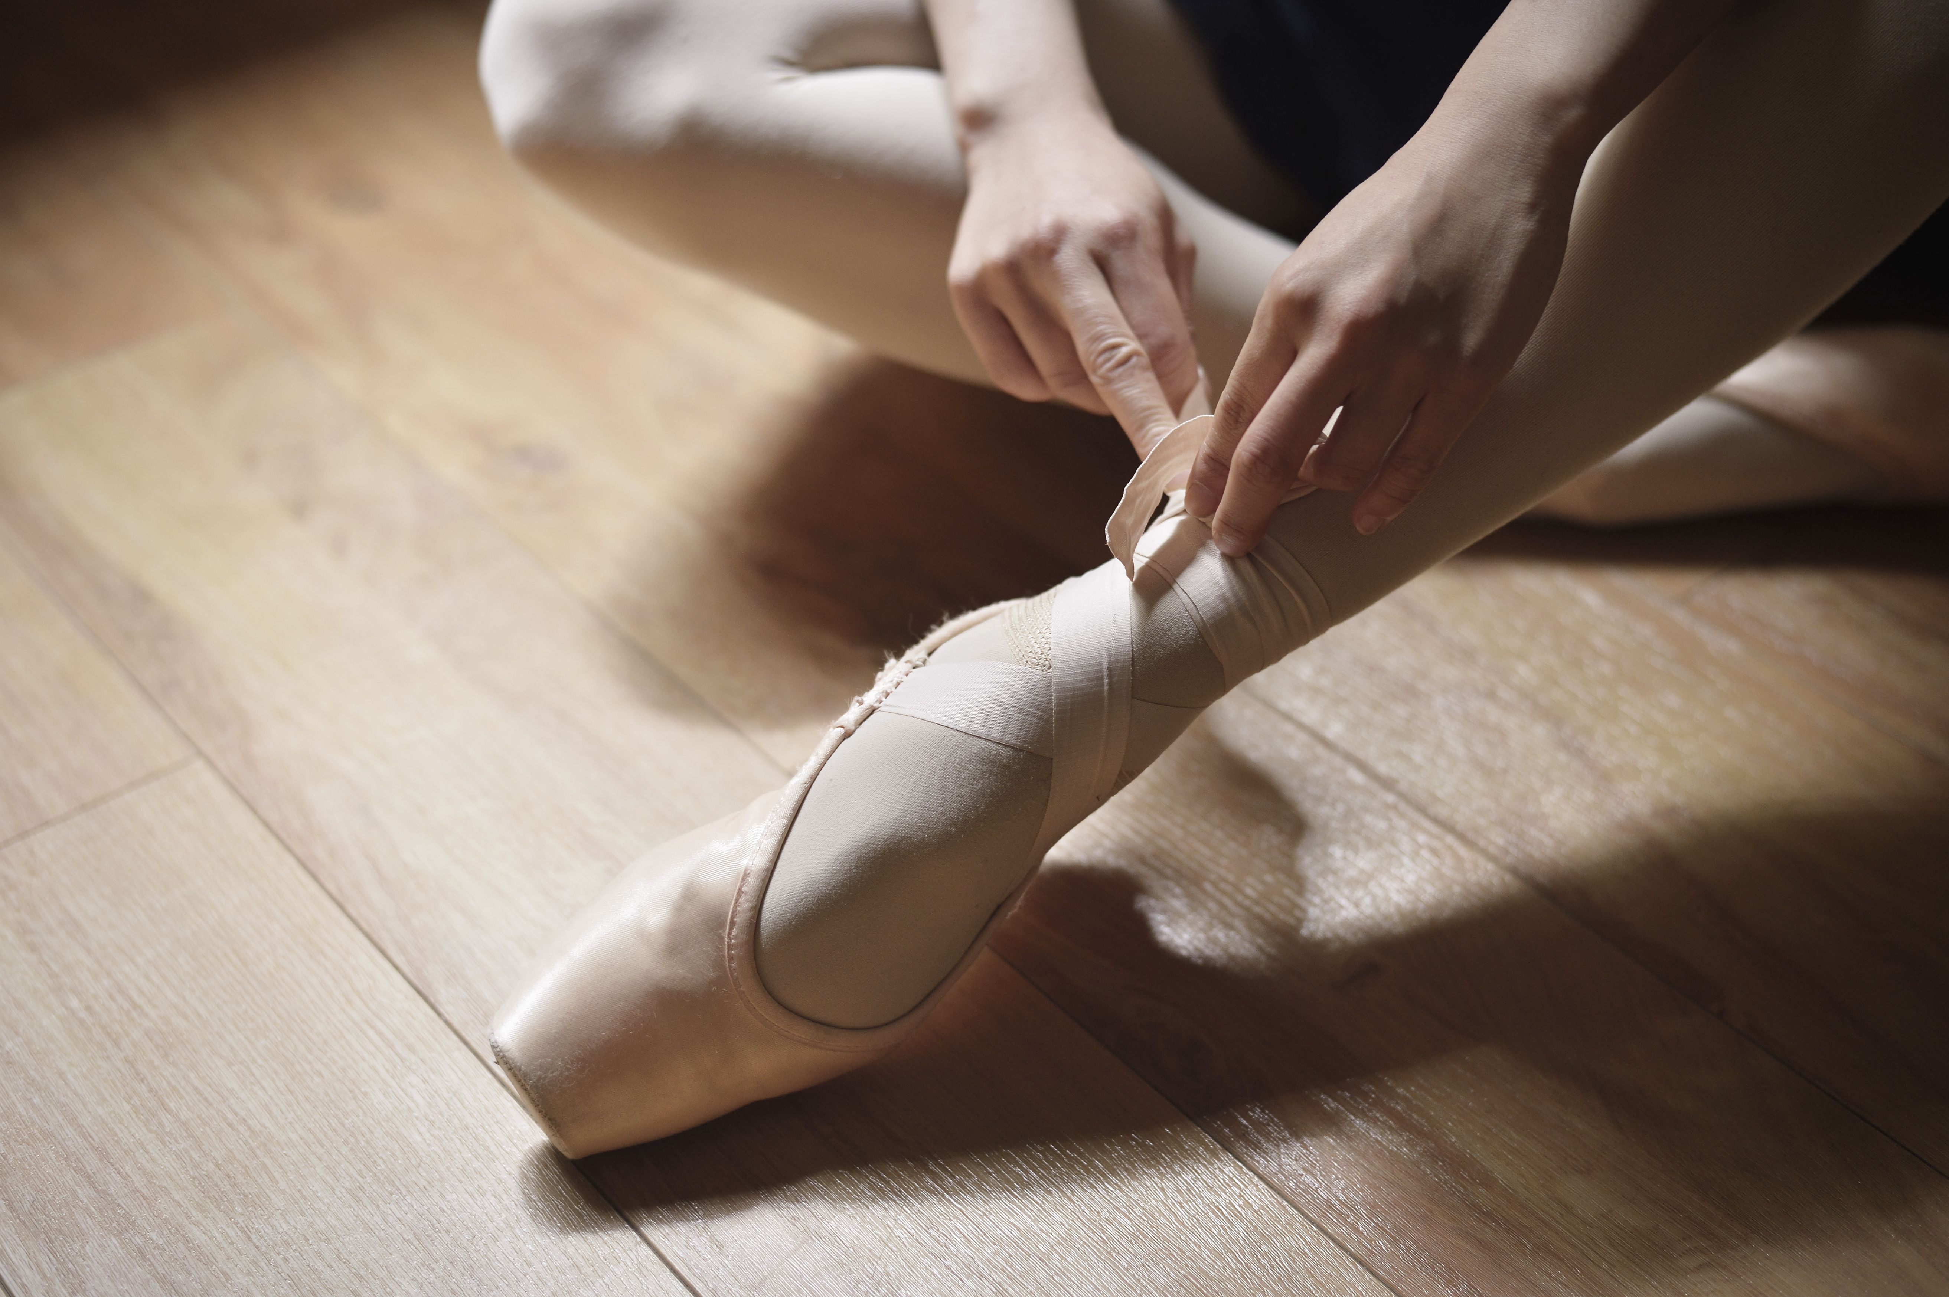
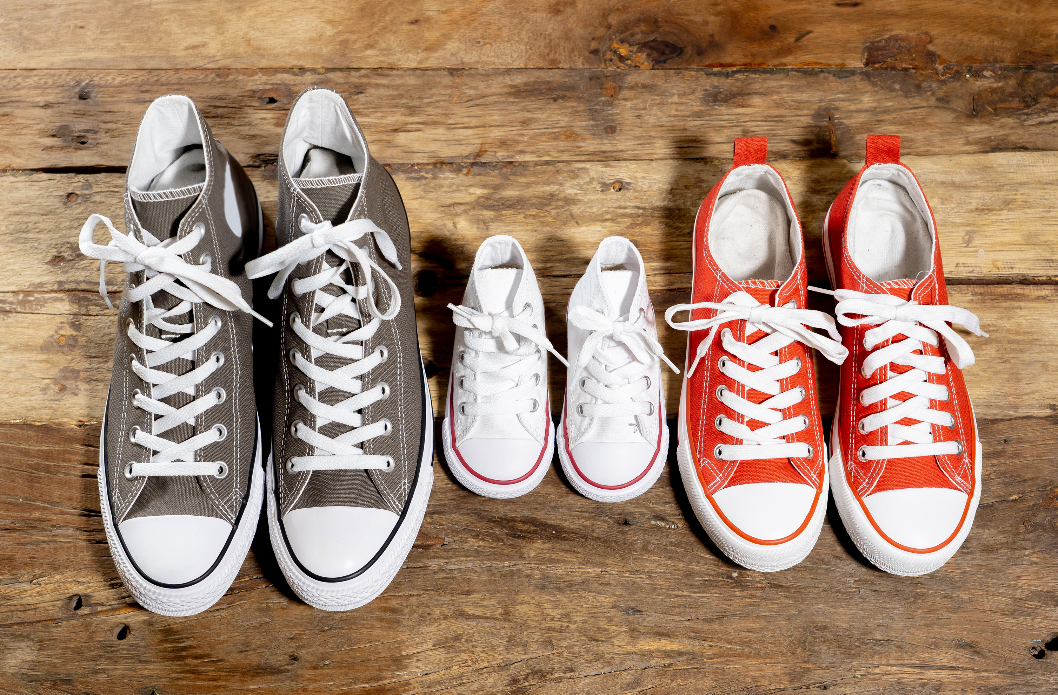
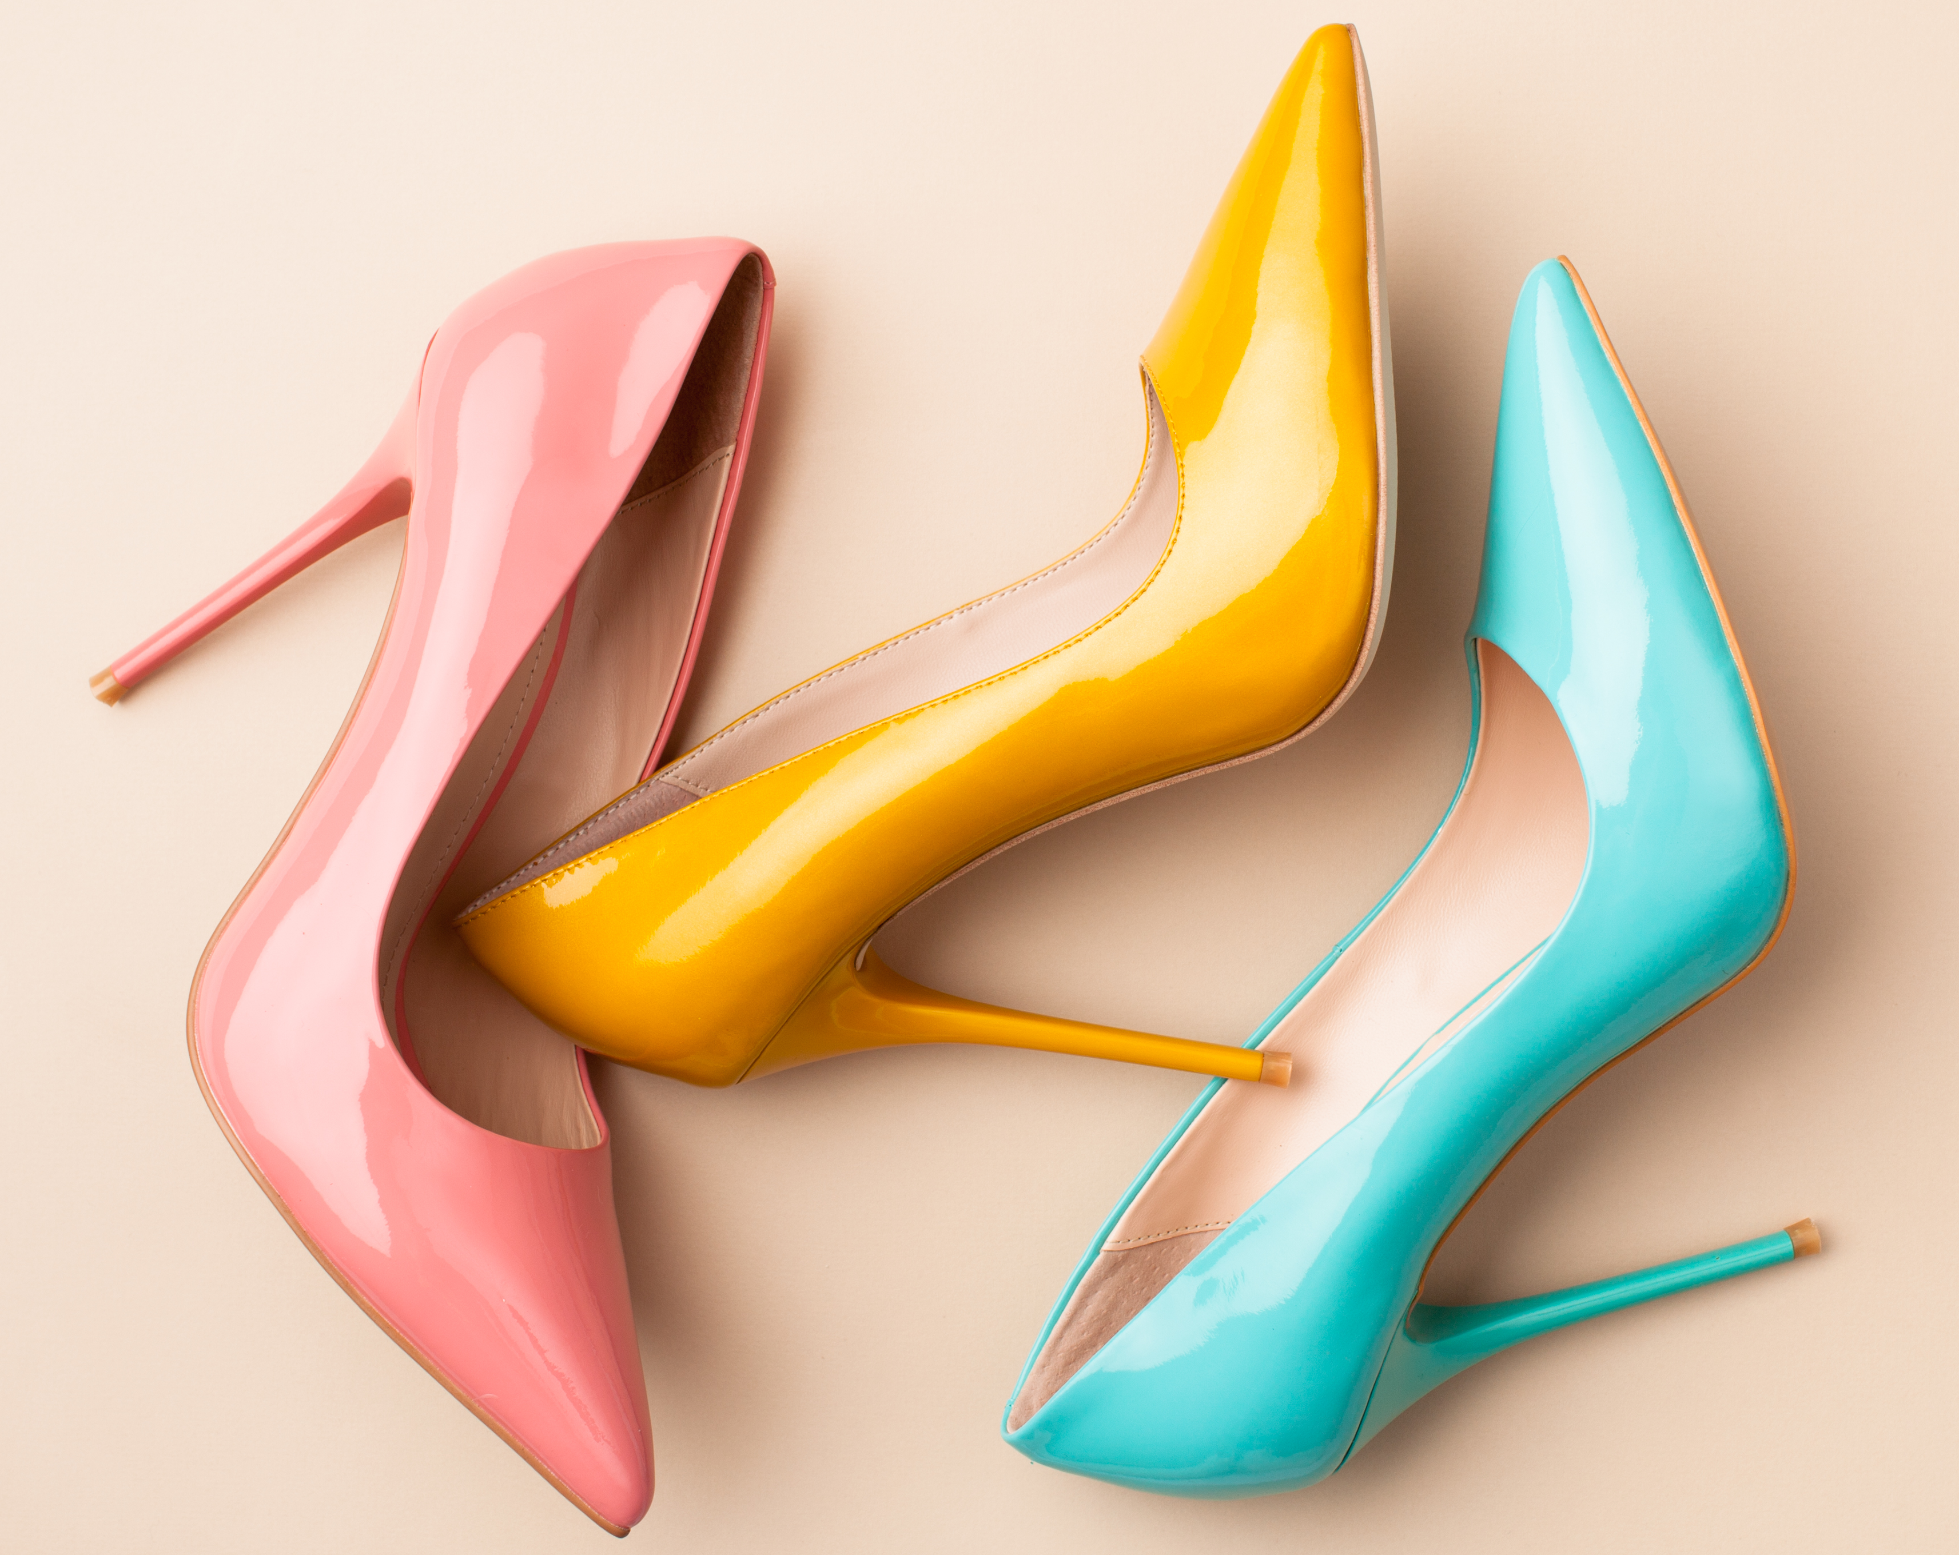
Example of Data
Age Group
Size
Color
Function
Heel
Closure
Top Material
…

Slide 9
Example of Data
Age Group
Size
Color
Function
Heel
Closure
Top Material
…
Variables

Slide 10
Example of Dataset
Columns == Variables
Age_Group | Size | Color | Function | Heel | Closure | Top_Material

Slide 11
Example of Dataset
Columns == Variables
Age_Group | Size | Color | Function | Heel | Closure | Top_Material
Row == Observation

Slide 12
Example of Dataset
Columns == Variables
Age_Group | Size | Color | Function | Heel | Closure | Top_Material
Adult | 7 | Black | Climb | N | Velcro | Fabric
Row == Observation
Cells == Values

Slide 13
Example of Dataset
Columns == Variables
Age_Group | Size | Color | Function | Heel | Closure | Top_Material
Adult | 7 | Black | Climb | N | Velcro | Fabric
Adult | 8 | Pink | Dressy | Y | None | Leather
Adult | 8 | Yellow | Dressy | Y | None | Leather
Adult | 8 | Blue | Dressy | Y | None | Leather
Adult | 6 | Pink | Ballet | N | Ribbon | Fabric
Adult | 10 | Grey | Everyday | N | Laces | Fabric
Baby | 1 | White | Everyday | N | Laces | Fabric
Adult | 7 | Red | Everyday | N | Laces | Fabric
Adult | 12 | Brown | Dressy | Y | Laces | Leather
Adult | 7.5 | Purple | Exercise | N | Laces | Fabric
Baby | 3 | Purple | Rain | N | None | Plastic
Child | 4 | Green | Rain | N | None | Plastic
Child | 4 | Grey | Rain | N | None | Plastic
Child | 6 | Yellow | Rain | N | None | Plastic
Adult | 7 | Red | Rain | N | None | Plastic
Cells == Values
Rows == Observations

Slide 14
Example of Dataset
Table
Age_Group | Size | Color | Function | Heel | Closure | Top_Material
Adult | 7 | Black | Climb | N | Velcro | Fabric
Adult | 8 | Pink | Dressy | Y | None | Leather
Adult | 8 | Yellow | Dressy | Y | None | Leather
Adult | 8 | Blue | Dressy | Y | None | Leather
Adult | 6 | Pink | Ballet | N | Ribbon | Fabric
Adult | 10 | Grey | Everyday | N | Laces | Fabric
Baby | 1 | White | Everyday | N | Laces | Fabric
Adult | 7 | Red | Everyday | N | Laces | Fabric
Adult | 12 | Brown | Dressy | Y | Laces | Leather
Adult | 7.5 | Purple | Exercise | N | Laces | Fabric
Baby | 3 | Purple | Rain | N | None | Plastic
Child | 4 | Green | Rain | N | None | Plastic
Child | 4 | Grey | Rain | N | None | Plastic
Child | 6 | Yellow | Rain | N | None | Plastic
Adult | 7 | Red | Rain | N | None | Plastic

Slide 15
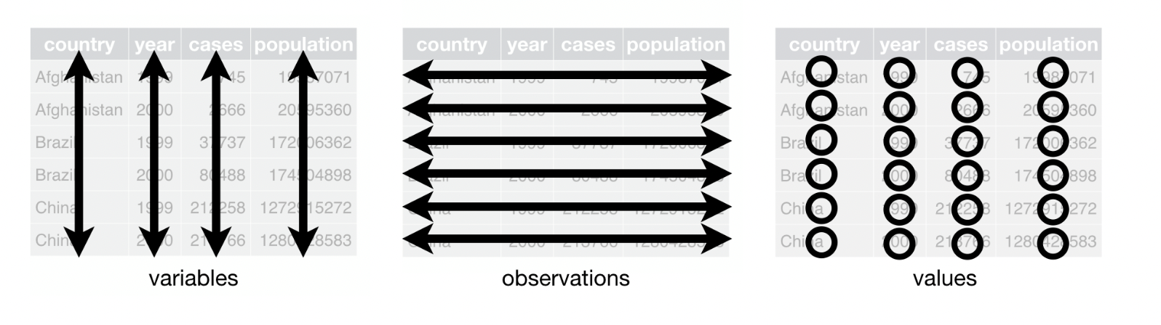
Table Vocabulary
columns
rows
cells

Slide 16
Variable (or data) Types
Variables
Age_Group | Size | Color | Function | Heel | Closure | Top_Material
Adult | 7 | Black | Climb | N | Velcro | Fabric
Adult | 8 | Pink | Dressy | Y | None | Leather
Adult | 8 | Yellow | Dressy | Y | None | Leather
Adult | 8 | Blue | Dressy | Y | None | Leather
Adult | 6 | Pink | Ballet | N | Ribbon | Fabric
Adult | 10 | Grey | Everyday | N | Laces | Fabric
Baby | 1 | White | Everyday | N | Laces | Fabric
Adult | 7 | Red | Everyday | N | Laces | Fabric
Adult | 12 | Brown | Dressy | Y | Laces | Leather
Adult | 7.5 | Purple | Exercise | N | Laces | Fabric
Baby | 3 | Purple | Rain | N | None | Plastic
Child | 4 | Green | Rain | N | None | Plastic
Child | 4 | Grey | Rain | N | None | Plastic
Child | 6 | Yellow | Rain | N | None | Plastic
Adult | 7 | Red | Rain | N | None | Plastic

Slide 17
Variable (or data) Types
Quantitative
Numeric
Ordered
Age_Group | Size | Color | Function | Heel | Closure | Top_Material
Adult | 7 | Black | Climb | N | Velcro | Fabric
Adult | 8 | Pink | Dressy | Y | None | Leather
Adult | 8 | Yellow | Dressy | Y | None | Leather
Adult | 8 | Blue | Dressy | Y | None | Leather
Adult | 6 | Pink | Ballet | N | Ribbon | Fabric
Adult | 10 | Grey | Everyday | N | Laces | Fabric
Baby | 1 | White | Everyday | N | Laces | Fabric
Adult | 7 | Red | Everyday | N | Laces | Fabric
Adult | 12 | Brown | Dressy | Y | Laces | Leather
Adult | 7.5 | Purple | Exercise | N | Laces | Fabric
Baby | 3 | Purple | Rain | N | None | Plastic
Child | 4 | Green | Rain | N | None | Plastic
Child | 4 | Grey | Rain | N | None | Plastic
Child | 6 | Yellow | Rain | N | None | Plastic
Adult | 7 | Red | Rain | N | None | Plastic

Slide 18
Variable (or data) Types
Quantitative
Numeric
Ordered
Size
7
8
8
8
6
10
1
7
12
7.5
3
4
4
6
7
Sequential Ordering
0

Slide 19
Variable (or data) Types
Quantitative
Numeric
Ordered
Rainfall (in.)
31.00
32.90
30.66
30.58
31.25
30.36
27.73
31.40
29.23
26.80
Sequential Ordering
0
https://www.bwsc.org/environment-education/rainfall-garden

Slide 20
Variable (or data) Types
Quantitative
Numeric
Ordered
Temp (C)
-2
10
-4
20
16
22
-10
-8
0
14
Divergent Ordering
0
https://www.bwsc.org/environment-education/rainfall-garden

Slide 21
Variable (or data) Types
Quantitative
Numeric
Ordered
Elevation (m)
-413
100
-40
200
1600
-555
1000
0
40
678
Divergent Ordering
0
https://www.bwsc.org/environment-education/rainfall-garden

Slide 22

Variable (or data) Types
Quantitative
Numeric
Ordered
stop-time
14:00
13:00
04:34
02:32
15:16
01:00
20:45
10:23
11:32
12:00
Cyclical Ordering
0

Slide 23
Variable (or data) Types
Work with whoever is next to you to come up with an example for each quantitative ordering
Quantitative
Sequential Ordering
Divergent Ordering
Cyclical Ordering
0
0
0

Slide 24



Variable (or data) Types
Categorical
Groups
Levels
Age_Group | Size | Color | Function | Heel | Closure | Top_Material
Adult | 7 | Black | Climb | N | Velcro | Fabric
Adult | 8 | Pink | Dressy | Y | None | Leather
Adult | 8 | Yellow | Dressy | Y | None | Leather
Adult | 8 | Blue | Dressy | Y | None | Leather
Adult | 6 | Pink | Ballet | N | Ribbon | Fabric
Adult | 10 | Grey | Everyday | N | Laces | Fabric
Baby | 1 | White | Everyday | N | Laces | Fabric
Adult | 7 | Red | Everyday | N | Laces | Fabric
Adult | 12 | Brown | Dressy | Y | Laces | Leather
Adult | 7.5 | Purple | Exercise | N | Laces | Fabric
Baby | 3 | Purple | Rain | N | None | Plastic
Child | 4 | Green | Rain | N | None | Plastic
Child | 4 | Grey | Rain | N | None | Plastic
Child | 6 | Yellow | Rain | N | None | Plastic
Adult | 7 | Red | Rain | N | None | Plastic

Slide 25
Variable (or data) Types
Categorical
Groups
Levels
Color
Black
Pink
Yellow
Blue
Pink
Grey
White
Red
Brown
Purple
Purple
Green
Grey
Yellow
Red
Color Levels:
Black
Pink
Yellow
Blue
Grey
White
Red
Brown
Purple
Green

Slide 26
Variable (or data) Types
Categorical
Groups
Levels
Function
Climb
Dressy
Dressy
Dressy
Ballet
Everyday
Everyday
Everyday
Dressy
Exercise
Rain
Rain
Rain
Rain
Rain
Function Levels:
Climb
Dressy
Ballet
Everyday
Exercise
Rain

Slide 27
Variable (or data) Types
Categorical
Groups
Levels
Heel
N
Y
Y
Y
N
N
N
N
Y
N
N
N
N
N
N
Heel Levels:
N
Y
Note: A categorical variable with exactly two level is also called a Binary Variable.
N == 0 == False
Y == 1 == True

Slide 28

Variable (or data) Types
Work with whoever is next to you to come up with two examples of categorical variables. Note the levels in your examples
Categorical
Binary

Slide 29



Variable (or data) Types
Ordinal
Groups
Levels
Ordered
Age_Group | Size | Color | Function | Heel | Closure | Top_Material
Adult | 7 | Black | Climb | N | Velcro | Fabric
Adult | 8 | Pink | Dressy | Y | None | Leather
Adult | 8 | Yellow | Dressy | Y | None | Leather
Adult | 8 | Blue | Dressy | Y | None | Leather
Adult | 6 | Pink | Ballet | N | Ribbon | Fabric
Adult | 10 | Grey | Everyday | N | Laces | Fabric
Baby | 1 | White | Everyday | N | Laces | Fabric
Adult | 7 | Red | Everyday | N | Laces | Fabric
Adult | 12 | Brown | Dressy | Y | Laces | Leather
Adult | 7.5 | Purple | Exercise | N | Laces | Fabric
Baby | 3 | Purple | Rain | N | None | Plastic
Child | 4 | Green | Rain | N | None | Plastic
Child | 4 | Grey | Rain | N | None | Plastic
Child | 6 | Yellow | Rain | N | None | Plastic
Adult | 7 | Red | Rain | N | None | Plastic

Slide 30
Variable (or data) Types
Ordinal
Groups
Levels
Ordered
Age_Group
Adult
Adult
Adult
Adult
Adult
Adult
Baby
Adult
Adult
Adult
Baby
Child
Child
Child
Adult
Sequential Ordering
Baby → Child → Adult

Slide 31
Variable (or data) Types
Ordinal
Groups
Levels
Ordered
Size
Sm
Lg
Sm
Med
Med
Lg
Sm
Lg
Lg
Med
Sm
Sequential Ordering
Sm → Med → Lg

Slide 32
Variable (or data) Types
Ordinal
Groups
Levels
Ordered
Attitude
Neutral
Dislike
Like
Neutral
Like
Like
Like
Neutral
Like
Dislike
Neutral
Divergent Ordering
Dislike ← Neutral → Like

Slide 33
Variable (or data) Types
Ordinal
Groups
Levels
Ordered
Month
Jan
Feb
Dec
Apr
Mar
Jan
Feb
Oct
Nov
Apr
May
Cyclical Ordering

Slide 34
Variable (or data) Types
Work with whoever is next to you to come up with an example for each ordinal ordering
Ordinal
Sequential Ordering
Divergent Ordering
Cyclical Ordering

Slide 35
Data Ethics

Slide 36
Responsible Consumption
What details should we look for when evaluating a data set?
Brainstorm with the person next to you and come up with at least 3 things

Slide 37
Responsible Consumption
What details should we look for when evaluating a dataset?
Who published the data?
Why collected the data?
Who funded collection of the data?
Who (or what) is included in the dataset?
Who (or what) is missing from the dataset?
Was the data transparently collected?
Was the data legally collected?
Are there any privacy issues?

